Slide 1
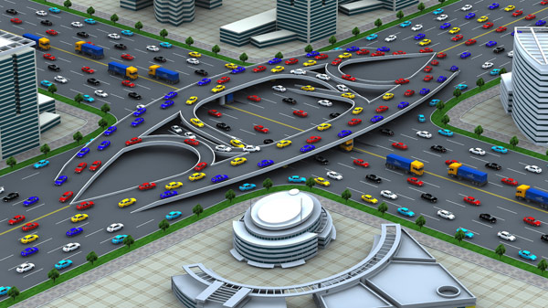
Traffic Engineering
University of Diyala
College of Engineering
Civil Engineering Department

Slide 2
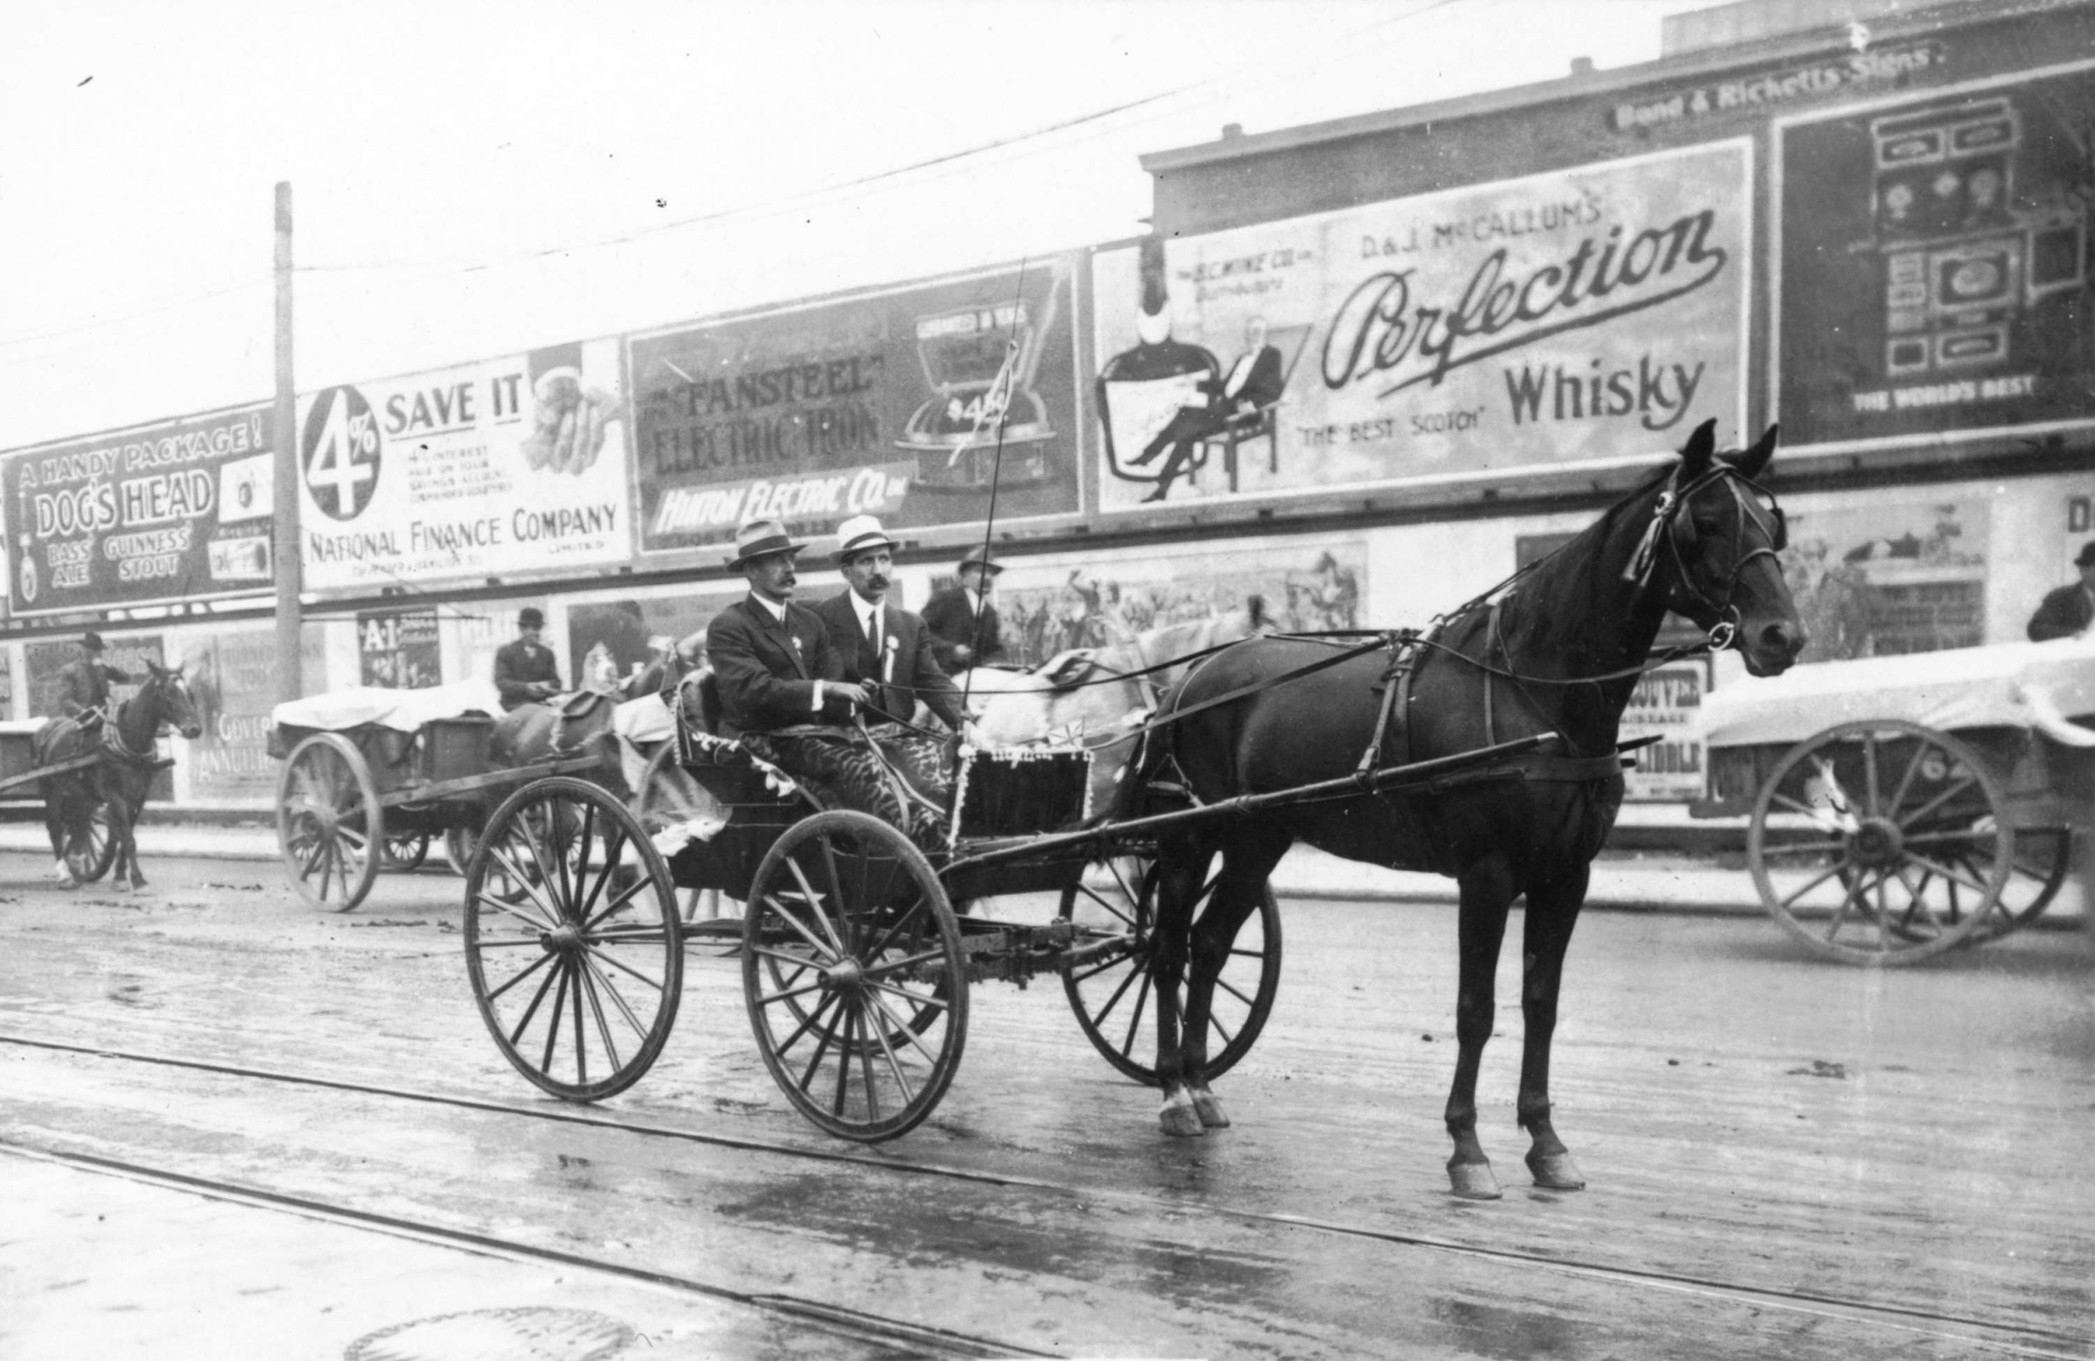
History
At Ancient Time
Slow Motion
Pollution
Accident

Slide 3
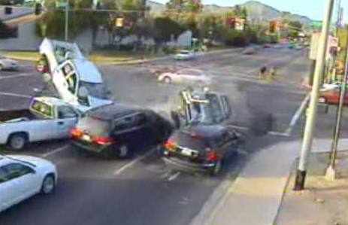
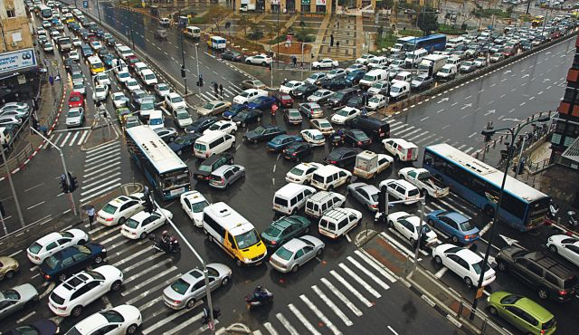
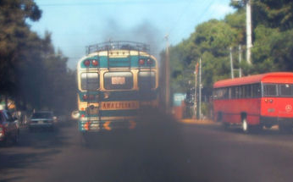
History
Accident
After invention of vehicles
Pollution
Slow Motion

Slide 4

Traffic Engineering
Organize
Control
Supply
Demand
It represents the number of trips that provided by existing transportation system.
It represents the number of trips required per day and depends on car ownership and population.

Slide 5
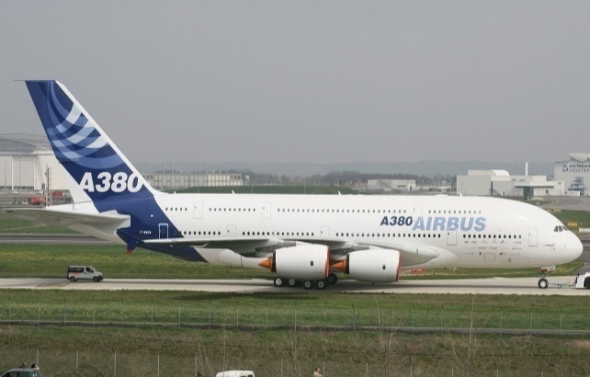
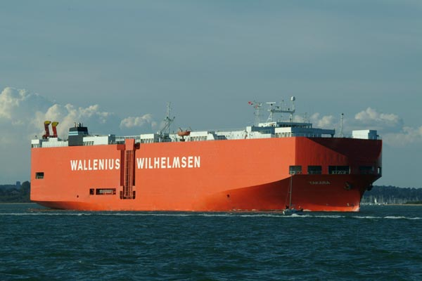
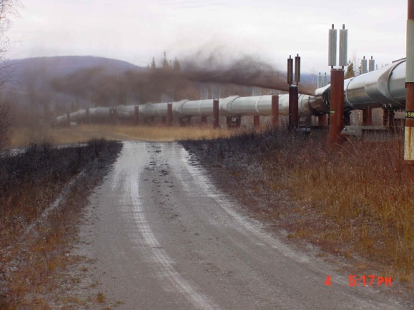
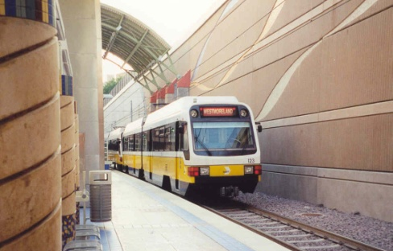
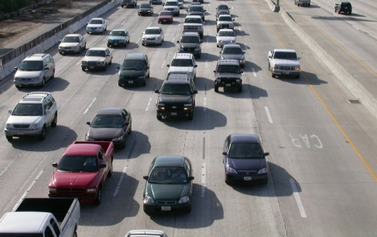
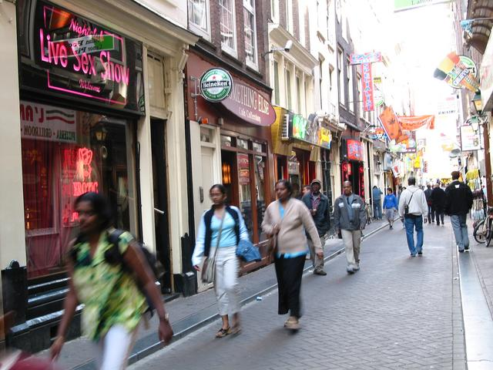
Traffic Engineering:
Definition from the Institute of Transportation Engineering (ITE)
“The phase of transportation engineering that deals with the planning, geometric design and traffic operations of roads, streets, and highways, their networks, terminals, abutting lands and relationship with other modes of transportation”

Slide 6
Elements of Traffic Engineering:
1. Traffic studies and characteristics
a. Data collection and analysis
b. Road users analysis
c. Traffic volume and demand
d. Speeds and travel time, delays
e. Origin and destination studies
2. Performance evaluation
Level of service: Speeds,
Convenience,
Safety,
Privacy,
Comfort,
Cost of travel

Slide 7
Elements of Traffic Engineering:
3. Facility design
a. Type of links and nodes in a network
b. Geometric
c. Terminal design
d. Lighting
4. Traffic control
a. Traffic regulations
b. Control devices – markings, signs and signals
c. Congestion management – pricing
d. Accidents

Slide 8
Elements of Traffic Engineering:
5. Traffic operations
a. Traffic efficiency measures – one-way street, etc.
b. Network controls – merging / diverging operations;
directional movements;
capacity constraints;
separation of flows
c. Curb management – parking, loading / unloading
6. Transportation systems management
a. Optimization of system capacity and operations
b. Highway occupancy – high-occupancy vehicle priority systems,
car pools,
road or area pricing

Slide 9
Urban Roads

Slide 10
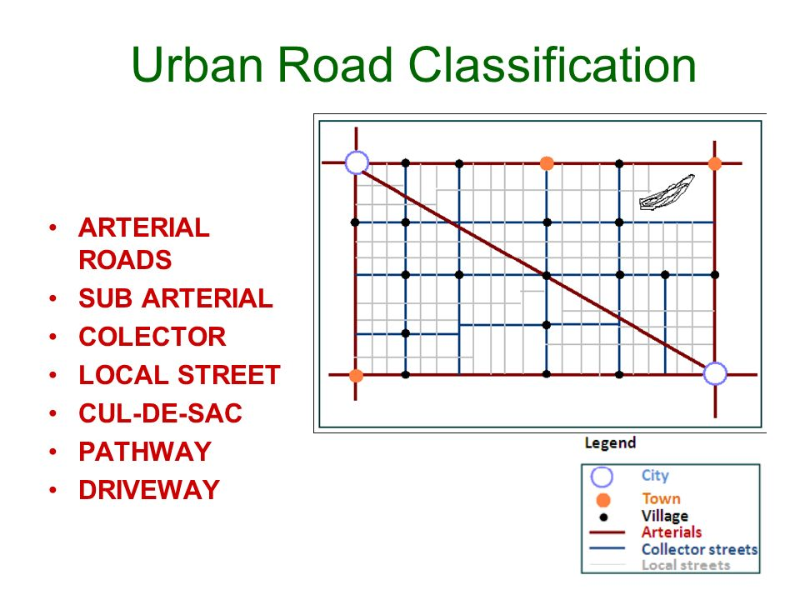
Rural Roads

Slide 11
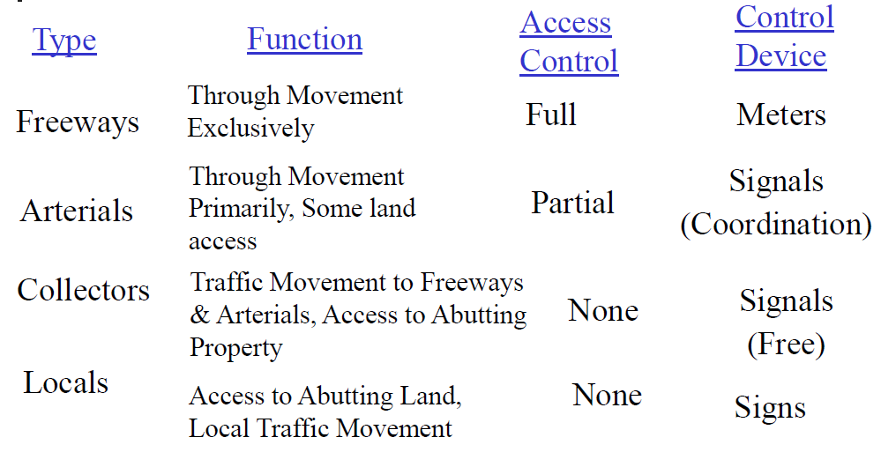

Slide 12
CHARACTERISTICS OF
THE ROAD USER

Slide 13
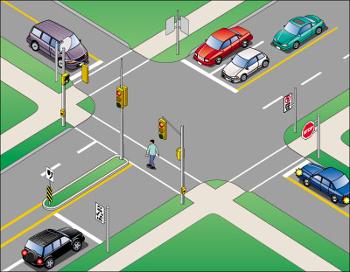
Components of Traffic System
Road users (drivers & pedestrians)
Vehicle ( Travel modes)
Roadway
Control devices (signs – signals – markings)

Slide 14
Driver Characteristics (Physiological)
A. Vision
I. Acuity: Ability to see with finer details.
Static:- driver and object both are stationary. Depends up on background brightness, contrast and time; optimal time required to identify an object is (0.5 – 1.0) sec
Dynamic:- at least one is moving
Cone (3º – 10º)
Fairly (10º – 12º)
Satisfactory (up to 20º)
Traffic signs and signals should be placed within cone of clear vision.

Slide 15
Driver Characteristics (Physiological)
A. Vision
II. Peripheral Vision: only movement of an object can be detected; This is the single most factor that allows the driver to estimate the travelling speed.
In Horizontal direction:- It is up to 90º towards right or left of centerline of pupil
In Vertical direction: - It is 60º above and 70º below line of sight. It is affected by the speed of the vehicle and age of the driver. At 30 km/hr it is 100º and at 100 km/hr it is 40º.If peripheral vision is < 40º then it is called ‘tunnel vision’.

Slide 16
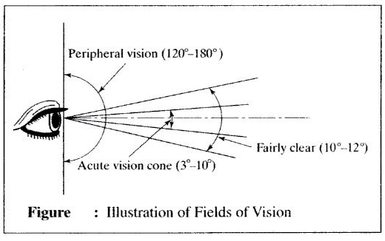

Slide 17
Driver Characteristics (Physiological)
A. Vision
III. Colour Vision
Allows differentiation between colours; in case of colour blind drivers blue pigment is added to green and yellow to red to assist them in recognizing the colours. May be that result disastrous.
IV. Glare vision and Recovery
Direct glare: relatively bright light appears in the individual’s field of vision
Specular glare: when image reflected by the bright light appears in the field of vision
Recovery: when moving from dark to light it is 3 sec; when moving from light to dark it is 6 sec.

Slide 18
Driver Characteristics (Physiological)
B. Hearing
Its influencing by old persons
C. Perception Reaction Time (PRT)
It has four stages:
detection, identification, decision, response
The PRT value is 2.5 sec. used in geometric design

Slide 19
Driver Characteristics (Psychological)
Motivations: driving to get to a destination fast
Intelligence: allows overcoming the hazardous situations
Emotion: road rage
Maturity: fast driving, overtaking
Learning
Skills

Slide 20
Pedestrian Characteristics
- Walking Speed:
HCM suggests a walking speed of 1.2 m/sec; in case of higher share of elderly (> 20%) it may be taken as 1 m/sec. It is used in signal timing.
Average walking speed of physically impaired is found to range between 0.6 m/s to 1.1 m/s for ‘above knee amputee’ and ‘wheelchair’ users.
2- Crossing Speed:
Design crossing speed taken in standards is 1.2 m/s
Crossing speeds of male pedestrians is found to be 1.22 m/s and that of female pedestrians as 1.11 m/s.

Slide 21
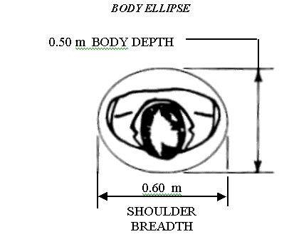
Pedestrian Characteristics
Space Occupied:
Defines the size of the facility; is dependent upon the shoulder width of the body of a person taken as 0.60 m and body width taken as 0.50m.

Slide 22
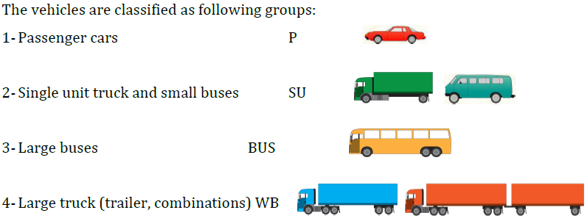
Vehicle Characteristics
Classification

Slide 23
Vehicle Characteristics
Static
Length: use in design of curve radius
Width : use in design of lanes and transit facilities
Height: use in select of bridge and tunnel height crossed
road
Load : use in select Longitudinal slops and structural
design

Slide 24
Vehicle Characteristics
Kinematic
Involve the motion of the vehicle without considering the forces that cause the motion.
Acceleration
Braking & deceleration
Steering & turning
Lighting
Power
Fuel economy
Operating cost

Slide 25
Vehicle Characteristics
Dynamic
Involve the forces that cause the motion of the vehicle.
Air resistance
Rolling resistance
Grade resistance
Inertia forces

Slide 26


